Slide 1
ECE5578 Multimedia Communication: Homework 4 Spring 2020
By Matthew Kayrish

Slide 2
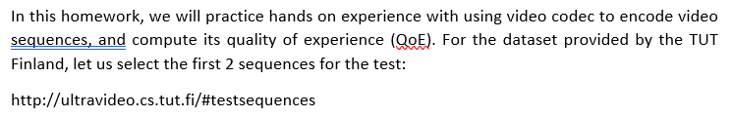
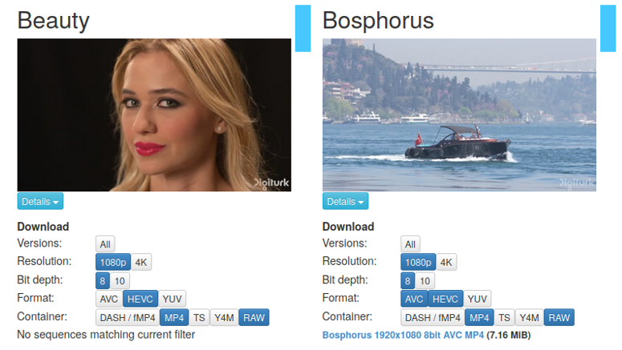
Homework 4: Introduction

Slide 3

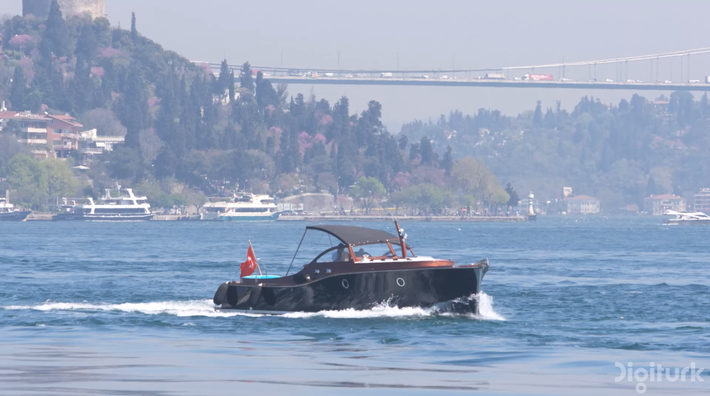
Homework 4: Original Videos
Beauty: 1080p, 120fps, YUV
Format: ‘.yuv’
Bosphorus: 1080p, 120fps, YUV
Format: ‘.yuv’

Slide 4
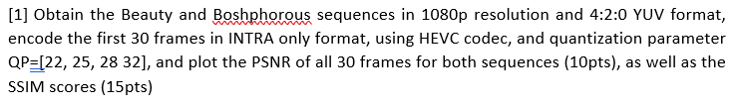

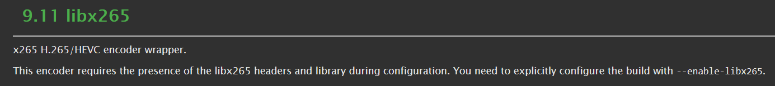
Homework 4: Problem 1

Slide 5
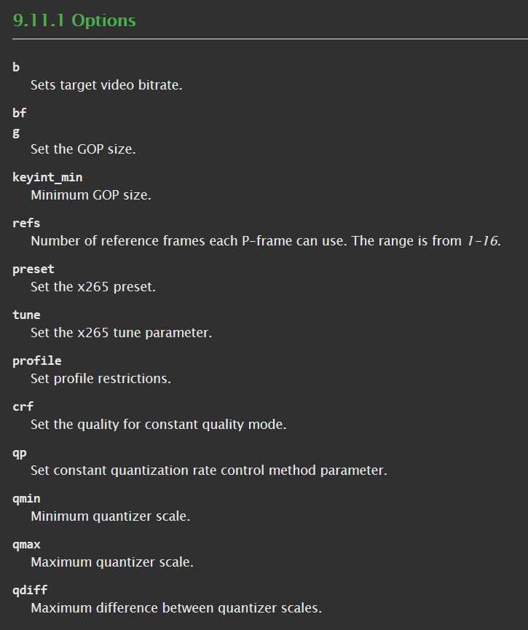
Homework 4: Problem 1

Slide 6
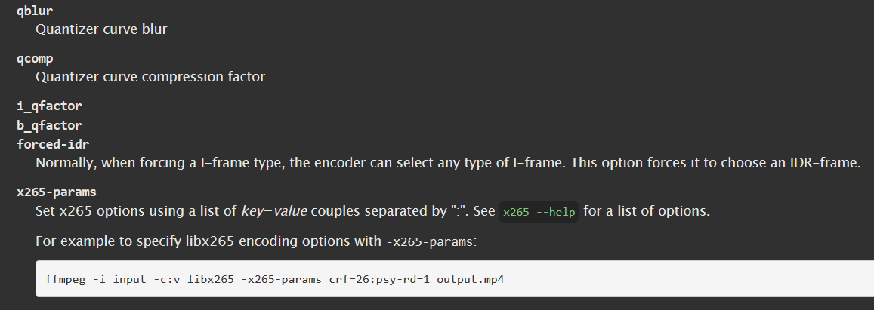
Homework 4: Problem 1

Slide 7
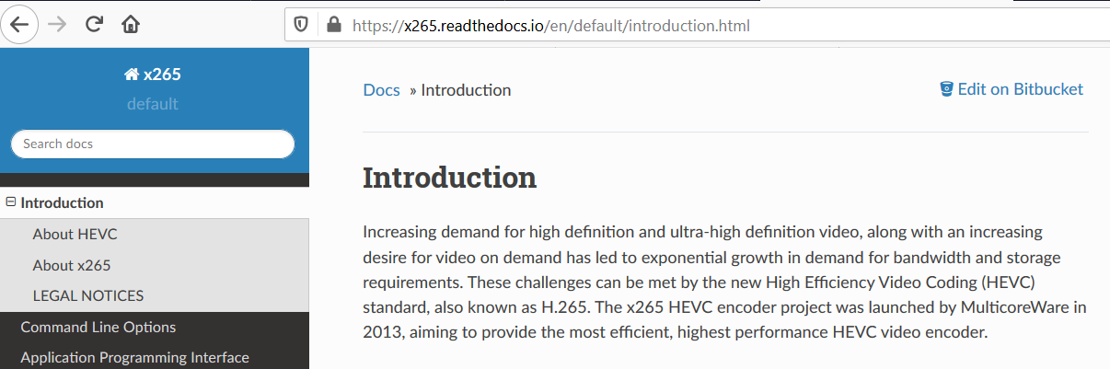
Homework 4: Problem 1

Slide 8
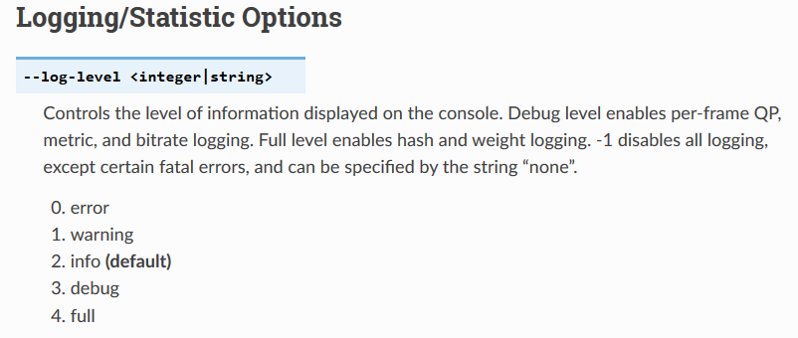
Homework 4: Problem 1

Slide 9
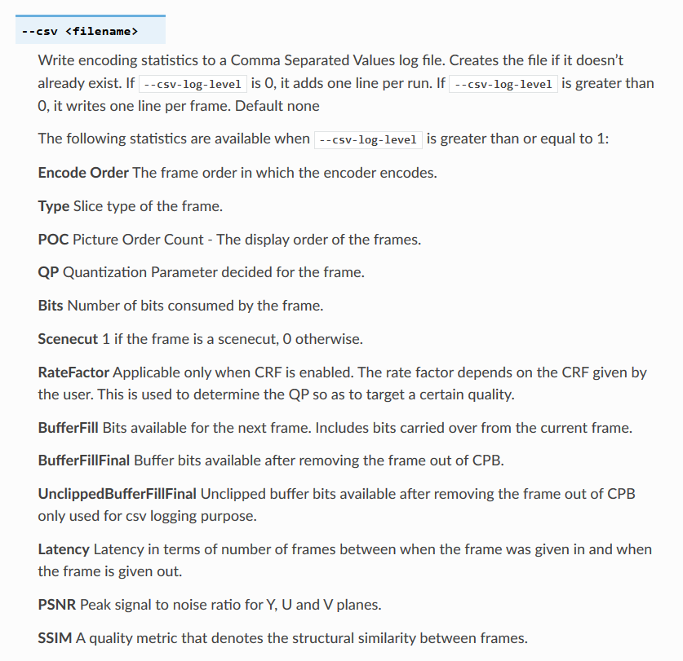
Homework 4: Problem 1

Slide 10
Homework 4: Problem 1

Slide 11
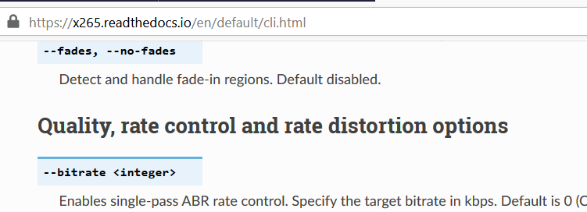
Homework 4: Problem 1

Slide 12
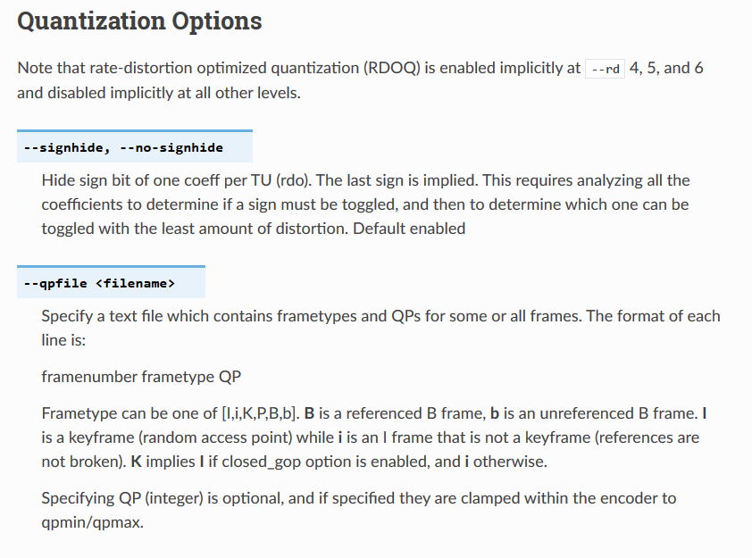
Homework 4: Problem 1

Slide 13
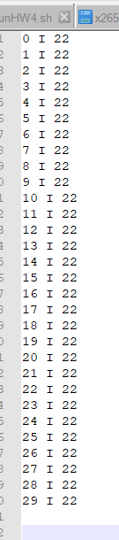
Homework 4: Problem 1

Slide 14
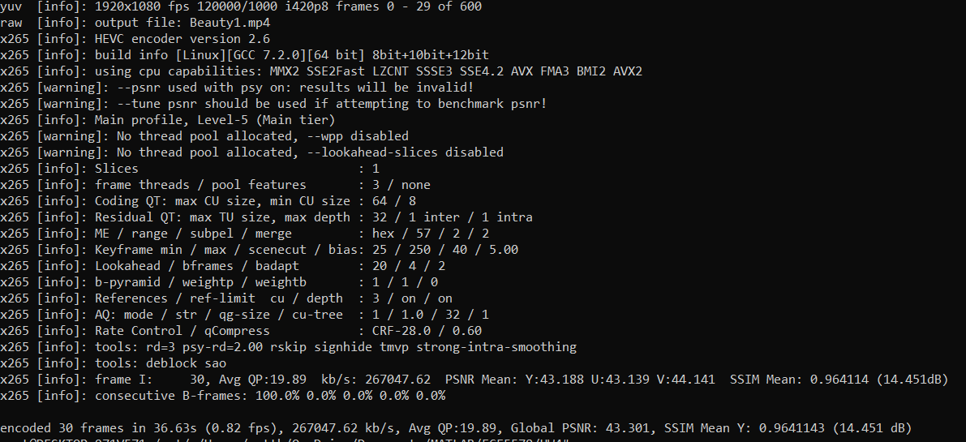
Homework 4: Problem 1
BREAKING DOWN THE COMMAND LINE!
Input File
Resolution ‘WxH’
Log Data per Frame Encoded
Refine and Log SSIM and PSNR
# X265 –input Beauty.yuv –f 30 –input-res ‘1920x1080’ –fps 120 –log-level 4 –csv log.csv –csv-log-level 2 --qpfile qp.txt -ssim –psnr –o Beauty1.mp4
HEVC Encoder
Number of Frames
Frame Rate
Quantization File
Output File
30 I-Frames, Global PSNR: 43.3 dB, Mean SSIM: 0.964

Slide 15
Homework 4: Problem 1
BEAUTY: QP=22, INTRA ONLY Console Output
30 I-Frames, Global PSNR: 43.3 dB, Mean SSIM: 0.964

Slide 16
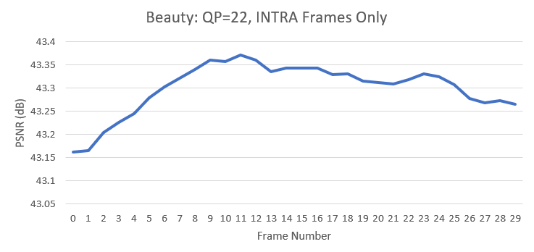
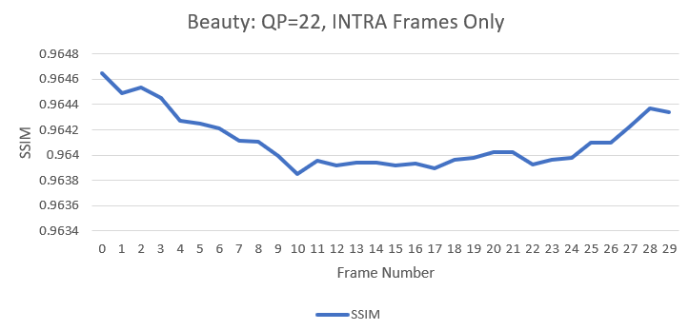
Homework 4: Problem 1
BEAUTY: QP = 22, INTRA ONLY
Global PSNR = 43.3 dB
Global SSIM = 0.964

Slide 17

Homework 4: Problem 1
BOSPHORUS: QP=22, INTRA ONLY Console Output
30 I-Frames, Global PSNR: 45.8 dB, Mean SSIM: 0.985

Slide 18
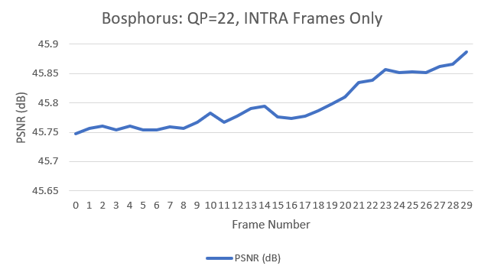
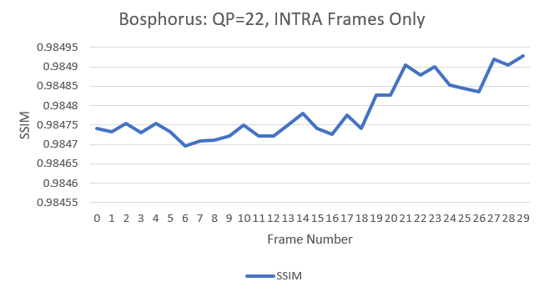
Homework 4: Problem 1
BOSPHORUS: QP = 22, INTRA ONLY
Global PSNR = 45.8 dB
Global SSIM = 0.964

Slide 19
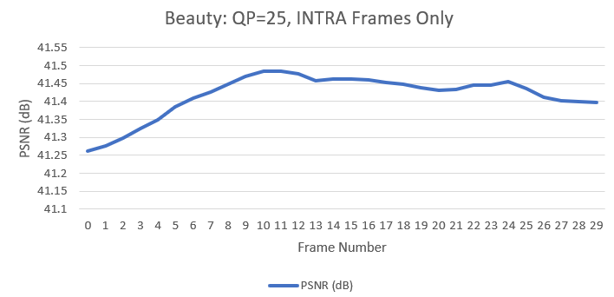
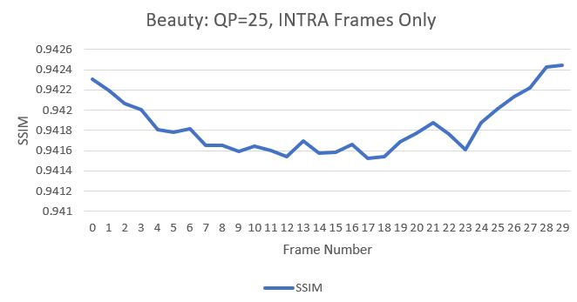
Homework 4: Problem 1
BEAUTY: QP=25, INTRA ONLY
30 I-Frames, Global PSNR: 41.4 dB, Mean SSIM: 0.942
Global SSIM = 0.942
Global PSNR = 41.4 dB

Slide 20
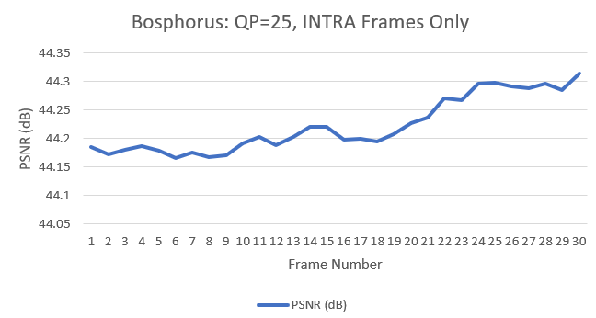
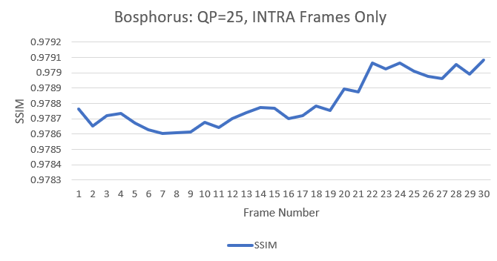
Homework 4: Problem 1
BOSPHORUS: QP=25, INTRA ONLY
30 I-Frames, Global PSNR: 44.2 dB, Mean SSIM: 0.997
Global SSIM = 0.997
Global PSNR = 44.2 dB

Slide 21
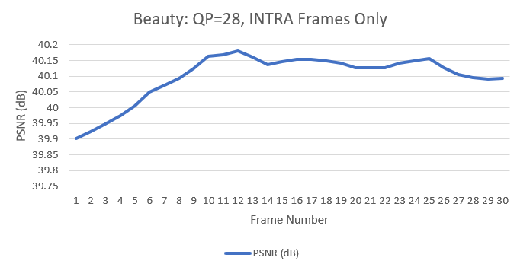
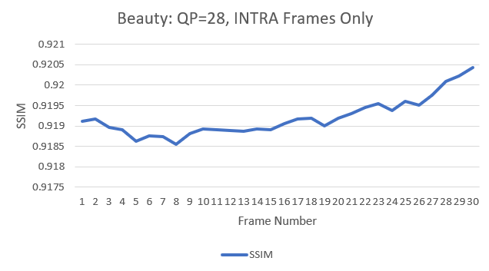
Homework 4: Problem 1
BEAUTY: QP=28, INTRA ONLY
30 I-Frames, Global PSNR: 40.1 dB, Mean SSIM: 0.919
Global SSIM = 0.919
Global PSNR = 40.1 dB

Slide 22
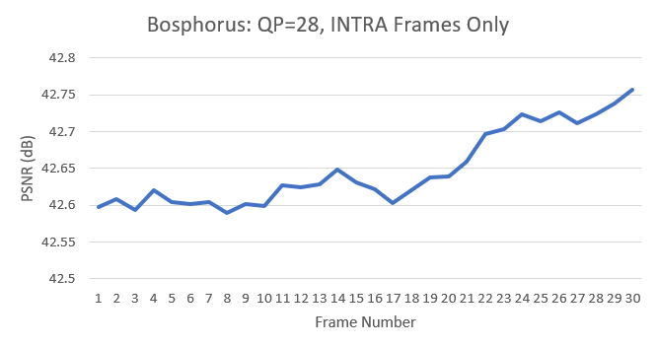
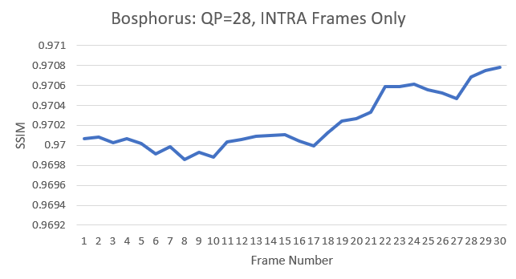
Homework 4: Problem 1
BOSPHORUS: QP=28, INTRA ONLY
30 I-Frames, Global PSNR: 42.6 dB, Mean SSIM: 0.970
Global PSNR = 42.6 dB
Global SSIM = 0.970

Slide 23
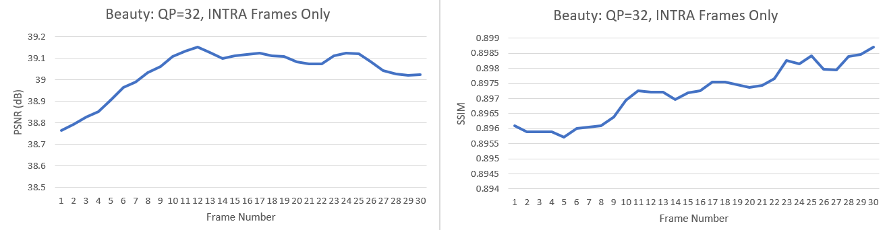
Homework 4: Problem 1
BEAUTY: QP=32, INTRA ONLY
30 I-Frames, Global PSNR: 39.0 dB, Mean SSIM: 0.897
Global SSIM = 0.897
Global PSNR = 39.0 dB

Slide 24
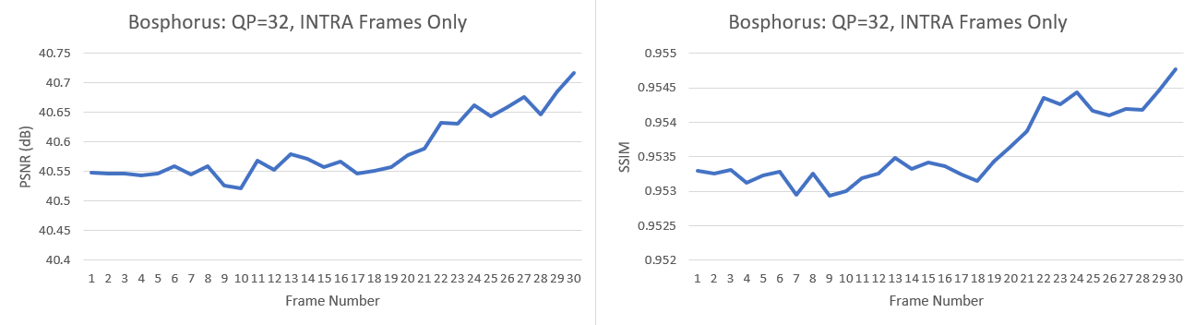
Homework 4: Problem 1
BOSPHORUS: QP=32, INTRA ONLY
30 I-Frames, Global PSNR: 40.6 dB, Mean SSIM: 0.954
Global PSNR = 40.6 dB
Global SSIM = 0.954

Slide 25
Homework 4: Problem 1
BEAUTY.yuv -> BEAUTY.mp4, 30 frames
QP | 22 | 25 | 28 | 32
PSNR | 43.3 | 41.4 | 40.1 | 39.0
SSIM | 0.964 | 0.942 | 0.919 | 0.897
BOSPHORUS.yuv -> BOSPHORUS.mp4, 30 frames
QP | 22 | 25 | 28 | 32
PSNR | 45.8 | 44.2 | 42.6 | 40.6
SSIM | 0.985 | 0.979 | 0.970 | 0.954
CONCLUSION: As QP Increases, the Quality of the reconstruction decreases. This is because
More data is lost as the Quantization Levels are wider and more data is
compressed within a single level.

Slide 26
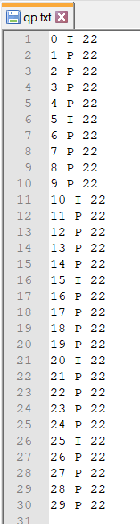
Homework 4: Problem 2
Step 1: Update the qp.txt file. CHANGE THE FRAME TYPE!

Slide 27
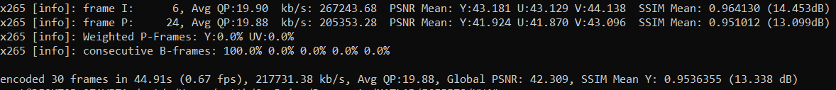
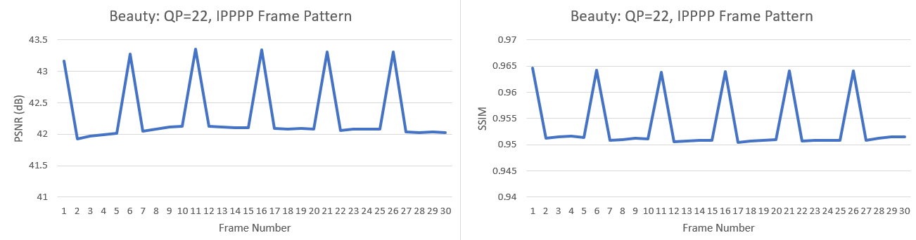
Homework 4: Problem 2
BEAUTY: QP=22, IPPPP Frames
30 I-Frames, Global PSNR: 42.3 dB, Mean SSIM: 0.954
Global PSNR = 42.3 dB
Global SSIM = 0.954

Slide 28
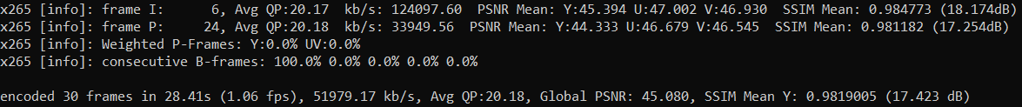
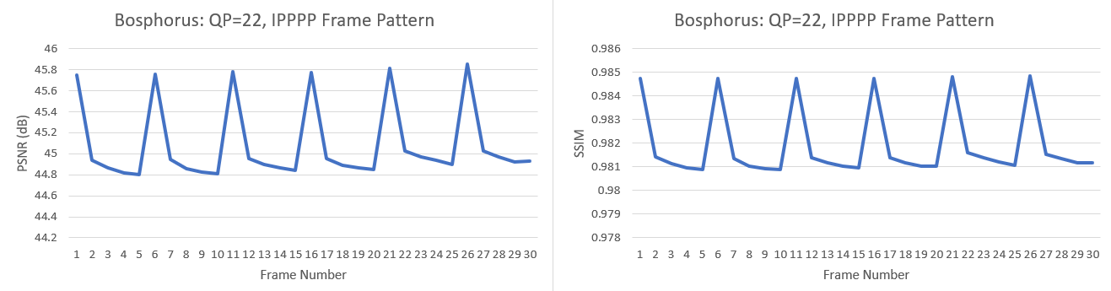
Homework 4: Problem 2
BOSPHORUS: QP=22, IPPPP Frames
30 I-Frames, Global PSNR: 45.1 dB, Mean SSIM: 0.982
Global PSNR = 45.1 dB
Global SSIM = 0.982

Slide 29
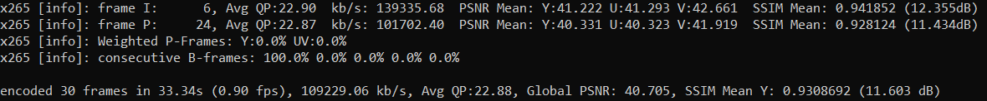
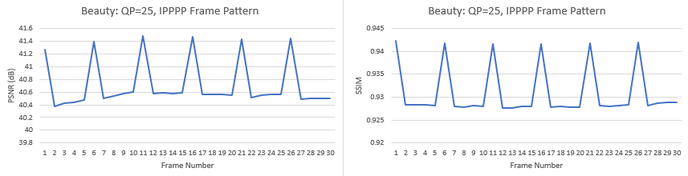
Homework 4: Problem 2
BEAUTY: QP=25, IPPPP Frames
30 I-Frames, Global PSNR: 40.7 dB, Mean SSIM: 0.931
Global PSNR = 40.7 dB
Global SSIM = 0.931

Slide 30
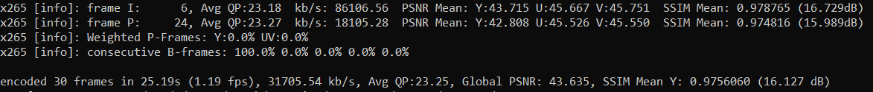
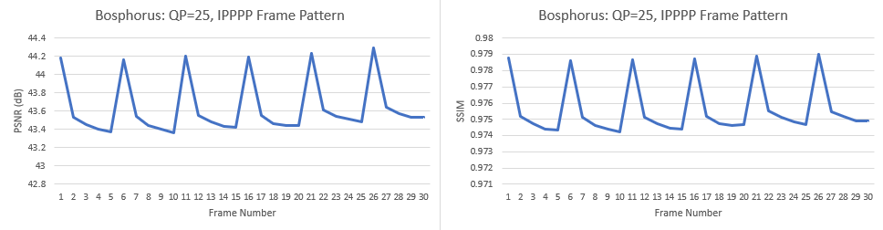
Homework 4: Problem 2
BOSPHORUS: QP=25, IPPPP Frames
30 I-Frames, Global PSNR: 43.6 dB, Mean SSIM: 0.976
Global PSNR = 43.6 dB
Global SSIM = 0.976

Slide 31
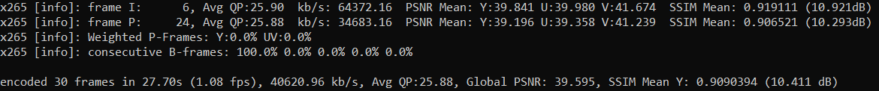
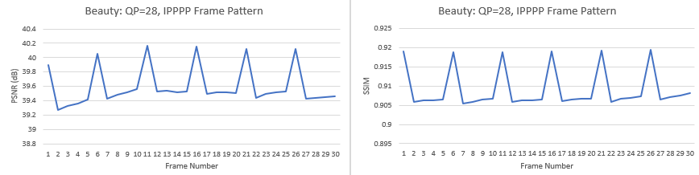
Homework 4: Problem 2
BEAUTY: QP=28, IPPPP Frames
30 I-Frames, Global PSNR: 39.6 dB, Mean SSIM: 0.909
Global PSNR = 39.6 dB
Global SSIM = 0.909

Slide 32
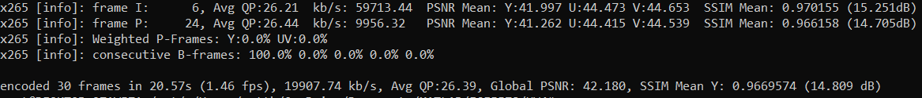
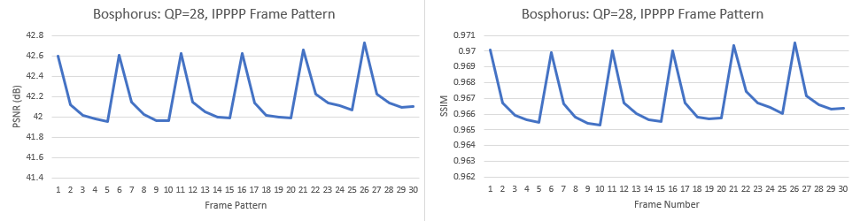
Homework 4: Problem 2
BOSPHORUS: QP=28, IPPPP Frames
30 I-Frames, Global PSNR: 42.2 dB, Mean SSIM: 0.967
Global PSNR = 42.2 dB
Global SSIM = 0.967

Slide 33
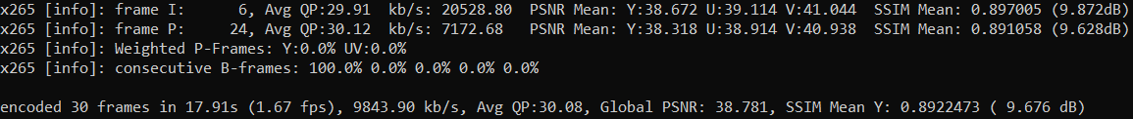
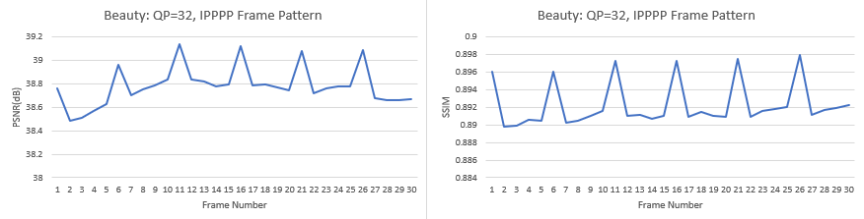
Homework 4: Problem 2
BEAUTY: QP=32, IPPPP Frames
30 I-Frames, Global PSNR: 38.8 dB, Mean SSIM: 0.892
Global PSNR = 38.8 dB
Global SSIM = 0.892

Slide 34
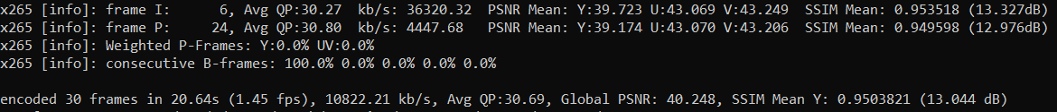
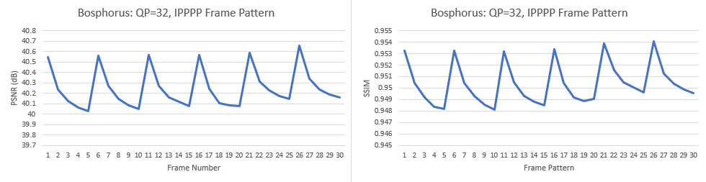
Homework 4: Problem 2
BOSPHORUS: QP=32, IPPPP Frames
30 I-Frames, Global PSNR: 40.2 dB, Mean SSIM: 0.950
Global PSNR = 40.2 dB
Global SSIM = 0.950

Slide 35
Homework 4: Problem 2
BEAUTY.yuv -> BEAUTY.mp4, 30 frames
QP | 22 | 25 | 28 | 32
PSNR | 42.3 | 40.7 | 39.6 | 38.8
SSIM | 0.954 | 0.931 | 0.909 | 0.892
BOSPHORUS.yuv -> BOSPHORUS.mp4, 30 frames
QP | 22 | 25 | 28 | 32
PSNR | 45.1 | 43.6 | 42.2 | 40.2
SSIM | 0.982 | 0.976 | 0.967 | 0.950
CONCLUSION: As QP Increases, the Quality of the reconstruction decreases. This is because
More data is lost as the Quantization Levels are wider and more data is
compressed within a single level. However, due to the replacement of I-Frames
P-Frames, the quality further decreased since frames were predicted from a single
frame, rather than each being encoded individually.

Slide 36
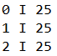
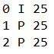
Homework 4: Problem 3
STEP 1: Encode using x265.
X265 –input Beauty.yuv –f 3 –input-res ‘1920x1080’ –fps 120 –log-level 2 \
–csv logBeautyIvP.csv –csv-log-level 1 –qpfile qp3.txt –ssim –psnr –o Beauty3P.mp4
First Run
Second Run
Beauty3I.mp4,
Bosphorus3I.mp4
Beauty3P.mp4,
Bosphorus3P.mp4

Slide 37
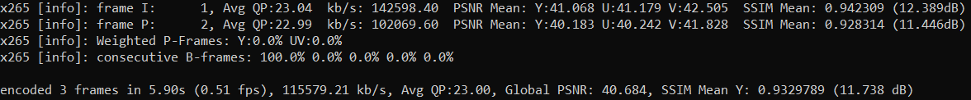
Homework 4: Problem 3
BEAUTY:QP=25, INTRA vs IPPPP
Vs.

Slide 38

Homework 4: Problem 3
BOSPHORUS: QP=25, INTRA vs IPPPP
Vs.

Slide 39
Homework 4: Problem 3
STEP 2: Use ffmpeg to create ‘.jpg’ files.
ffmpeg –I Beauty3I.mp4 –c:v mjpeg BeautyI%d.jpg
ffmpeg –I Bosphorus3I.mp4 –c:v mjpeg BosphorusI%d.jpg

Slide 40
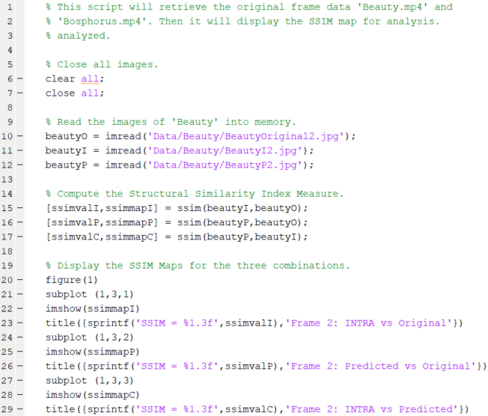
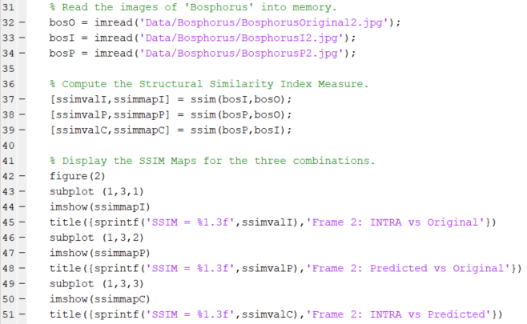
Homework 4: Problem 3
STEP 3: Compute the SSIM Map and Plot Using MATLAB
Compute the SSIM Map for ‘Beauty’
Compute the SSIM Map for ‘Bosphorus’

Slide 41


Homework 4: Problem 3
Compare the SSIM Map for ‘Beauty’
Compare the SSIM Map for ‘Bosphorus’

Slide 42
Homework 4: Problem 3
‘Beauty’ Observations
‘Bosphorus’ Observations
‘White Noise’ appeared in the region surrounding the ‘Beauty’s’ head. This is because the region is very low frequency with little variation. The reconstruction was able to reconstruct this region very well.
The ‘Beauty’s’ was very ‘white’. This indicates regions of subtle variations in the reconstruction and increased texture.
The SSIM values of greater than 90% indicate that there is a lot of similarities in the original image and the encoded image. This indicates a strong reconstruction and encoding scheme.
There was some soft ‘white noise in the general shape of the background. This is because there is little variation in the background, especially around the bridge and the base of the water.
There is a lot of white in the area of the water and the boat. This is because of subtle variations and increased texture.
The SSIM values of greater than 90% indicate that the encoded image and the original image are very similar, indicating a strong encoding scheme.

Slide 43
Homework 4: Conclusion
For Homework 4, we studied the impact of quantization parameters and encoding schemes on the Quality of Experience. In general, the frames that were INTRA-encoded had a better quality of service, however they inflated the playback files. For video-streaming over the internet, this is obviously not desired.
The P-encoded Frames had only a minimal deterioration in quality and the file size was significantly smaller. This scheme is the optimal choice for video streaming due to the smaller bandwidth requirement and the comparable performance.

